Slide 1

Reinforcement Learning 4 Next Best Actions
Eden Hazard is the best of all time –
(NON)impartial AI

Slide 2
Machine Learning Classes
Machine Learning
Supervised Learning
Unsupervised Learning
Reinforcement Learning
XGBOOST, Decision Tree, Regression, SVM etc. where a label to target is available. Task Driven and non adaptable
Kmeans, Hierarchical Clustering etc. where irrespective of a target, segment data points into groups of similarity
Learn From Mistakes optimized on maximizing reward just like how humans do [Q Learning, Deep Q Networks, Policy Learning etc]. Able to react and adapt to environment

Slide 3
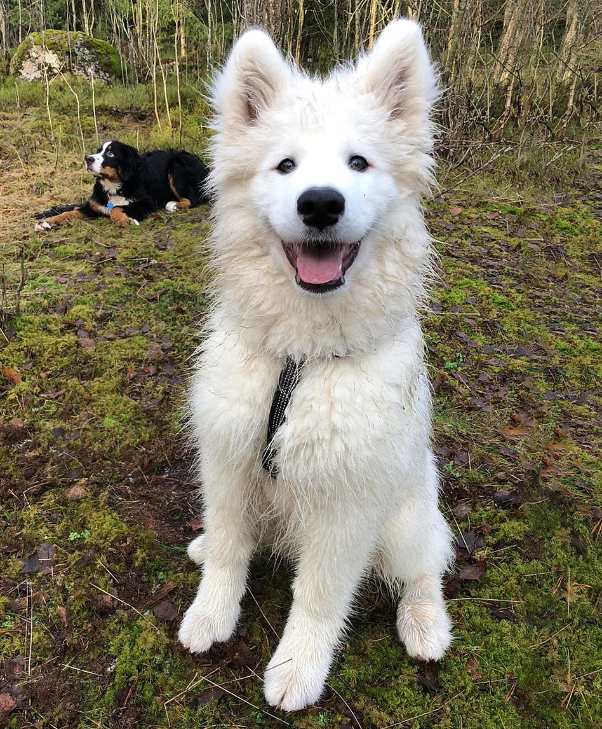


REINFORCEMENT LEARNING - EXPLAINED
In RL, there is an Environment, Agent, State, Action and Reward.
Assumed to follow Markovian Decision Property where environment is observable, and the current state characterizes the process
Basic Idea of Reinforcement Learning is similar to training a dog
The Environment be the backyard as shown below with 3 puddle blocks, and 13 clean blocks for the dog to play at
The states be these individual blocks, agent being the dog and actions left, right, top or bottom.
Reward is based on his actions, in this case a positive reward if he avoids the puddles all throughout and doesn’t get dirty or a negative reward if else.
Good Boy!
Have a treat
Bad Boy!
No Chew toy for an hour
Over few iterations of training he would learn what to do to earn a treat
And avoid the worst
The same can be extended to any situation with an online or offline learning applicable
Or make him watch an entire united game –
That’s too cruel.

Slide 4

REINFORCEMENT LEARNING - EXPLAINED
Through iterative learning, the agent will know for every state, what action maximizes the reward
Not only that the actions maximizes the reward, it also is sequential and hence the causal relation of actions are also captured properly as a function of reward while optimizing
There are multiple different approaches built around this idea, although we would focus on Q Learning for the rest of the slides

Slide 5
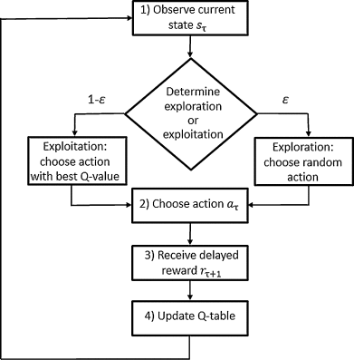
REINFORCEMENT LEARNING – Q Learning
Q-learning is an off policy reinforcement learning algorithm that seeks to find the best action to take given the current state.
It’s considered off-policy because the q-learning function learns from actions that are outside the current policy, like taking random actions, and therefore a policy isn’t needed.
Q-learning seeks to learn a policy that maximizes the total reward.
There are two sets of actions the agent can take: Exploitation and Exploration
In exploitation, the agent uses Q table as reference and then selects next best action in order to maximize the reward
In exploration, agent randomly selects actions that lets the agent explore new set of actions that may not have been present in the previous Q table and learns to adapt to maximize reward
Both the mode of actions are important and should likely complement each other in the process. The balance among them is set by an epsilon parameter with greedy approach
Q Learning Flowchart

Slide 6
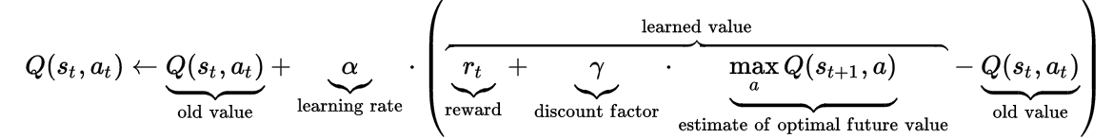
REINFORCEMENT LEARNING – Q Learning
Q table gets updated on every iteration as is shown in the flowchart
In order to teach the agent, the best action i.e. in order to maximize the reward, Q value for current state action pair is updated by applying the bellman expectation equation (Value of a particular state conditioned to an action)
Alpha is the learning rate. The parameter can take a value from 0-1, where 0 means the Q table never gets updated whereas a higher value means learning happens very quickly, although at the cost of not converging properly
Gamma is the discount factor. The parameter can take a value from 0-1 which determines the importance to future rewards. A small value provides importance to immediate rewards only where as higher value provides importance to future rewards too.
maxQ gives the maximum value for Q for all possible actions in next state

Slide 7
Q Learning – In Action
Initial Q Table
0 | 0 | 0 | 0
0 | 0 | 0 | 0
0 | 0 | 0 | 0
0 | 0 | 0 | 0 -Start
First Random Step
0 | 0 | 0 | 0
0 | 0 | 0 | 0
0 | 0 | 0 | 0
0 | 0 | 0 | 0.5
0 | 0 | 0 | 0
0 | 0 | 0 | 0
0 | 0 | 0 | 0.5
0 | 0 | 0 | 0.5
0 | 0 | 0 | 0
0 | 0 | 0 | 0
0 | 0 | 0.5 | 0.5
0 | 0 | 0 | 0.5
Reward Table
Q Table for Exploitation Learning
-10 | 5 | 5 | 5
-10 | 5 | 5 | 5
5 | 5 | 5 | 5
5 | -10 | 5 | 5
-4.1 | 6.8 | 4 | 2.8
-3.8 | 7.9 | 8.9 | 7.6
3.9 | 5.6 | 7.5 | 7.7
2.4 | -2.2 | 5.7 | 3.6
0 | 0 | 0 | 0
0 | 0 | 0 | 0
0 | -1 | 0.5 | 0.5
0 | 0 | 0 | 0.5
0 | 0 | 0 | 0
0 | 0 | 0 | 0
0 | -1 | 0.5 | 0.5
0 | 0 | 0 | 0.5
After 160 Radom Iteration
Alpha = 0.1, Gamma=0.9
Further exploitation learning helps to optimize the next best action at every state. Exploitation learning continues till it converges to the optimal Q values

Slide 8
REINFORCEMENT LEARNING VS SUPERVISED LEARNING

